Slide 1
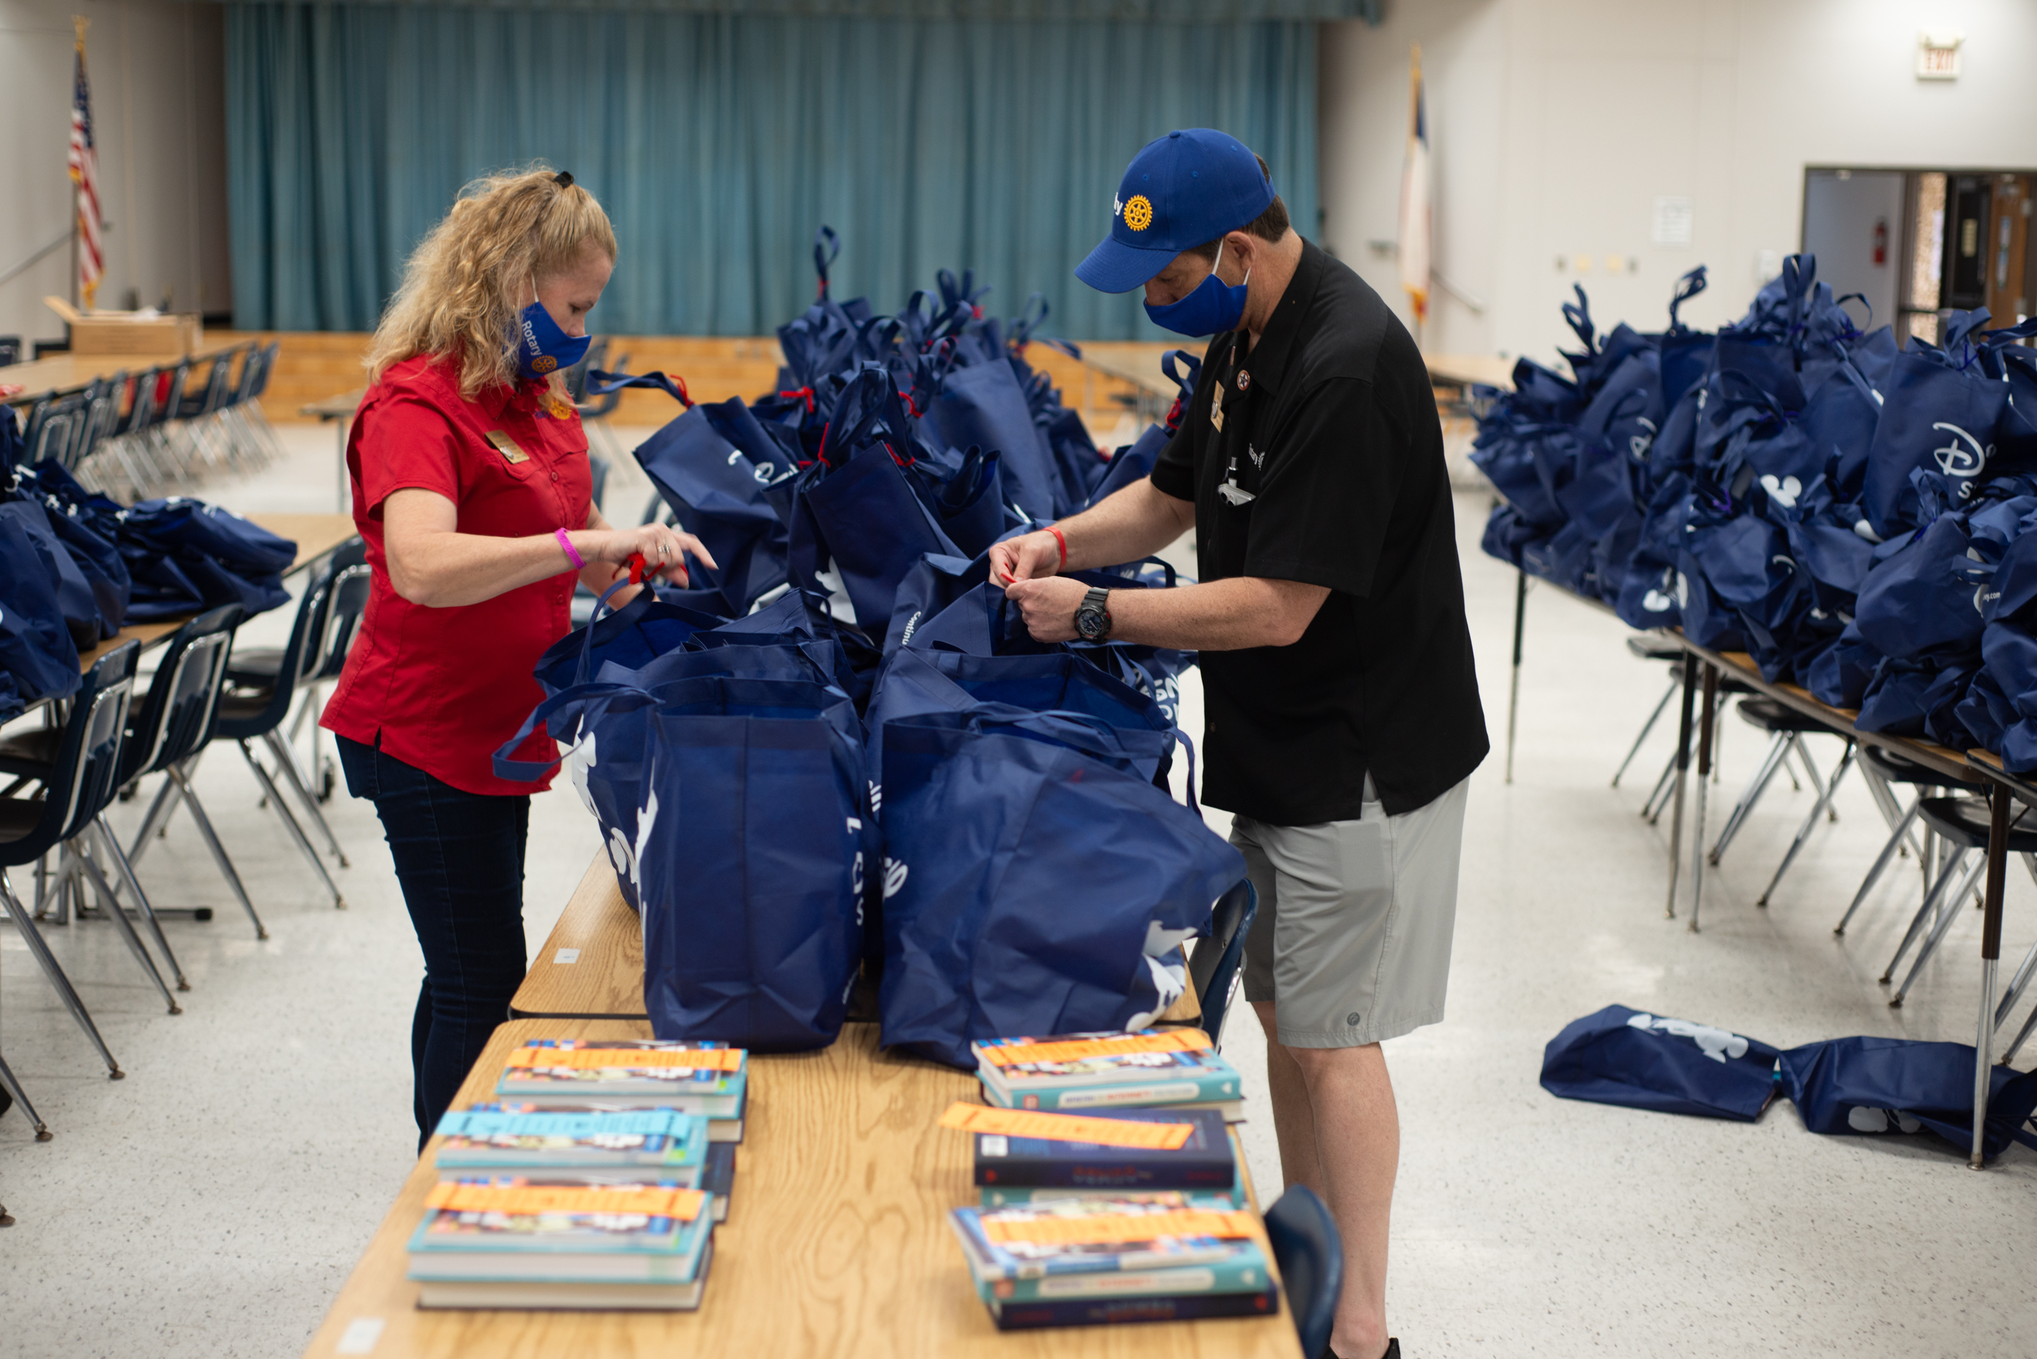
THE STATE OF MEMBERSHIP
As of 1 January 2022
ROTARY INTERNATIONAL
Notes:
NOTE TO SPEAKER: Customize this presentation for your region. At a minimum, you will need to customize slide 6: Replace the X’s with data from Rotary Club Central or delete them. Unhide the slide (in the Slide Show menu, choose Hide Slide) so it’s visible during the presentation. Compare global trends with what’s happening in your region.
SPEAKER: When Rotary’s membership is strong, our clubs are more vibrant, Rotary is more visible, and our members have more resources to help communities flourish. To accomplish everything we want to do, we need our club, district, and zone leaders to commit to growing Rotary and Rotaract. That’s why growing our membership is our top internal organizational priority.
Today, I’m going to tell you about the current state of our membership as of January 2022 and give you ideas for reaching the goals of our Action Plan. Those include increasing our impact, expanding our reach, enhancing participant engagement, and increasing our ability to adapt.

Slide 2
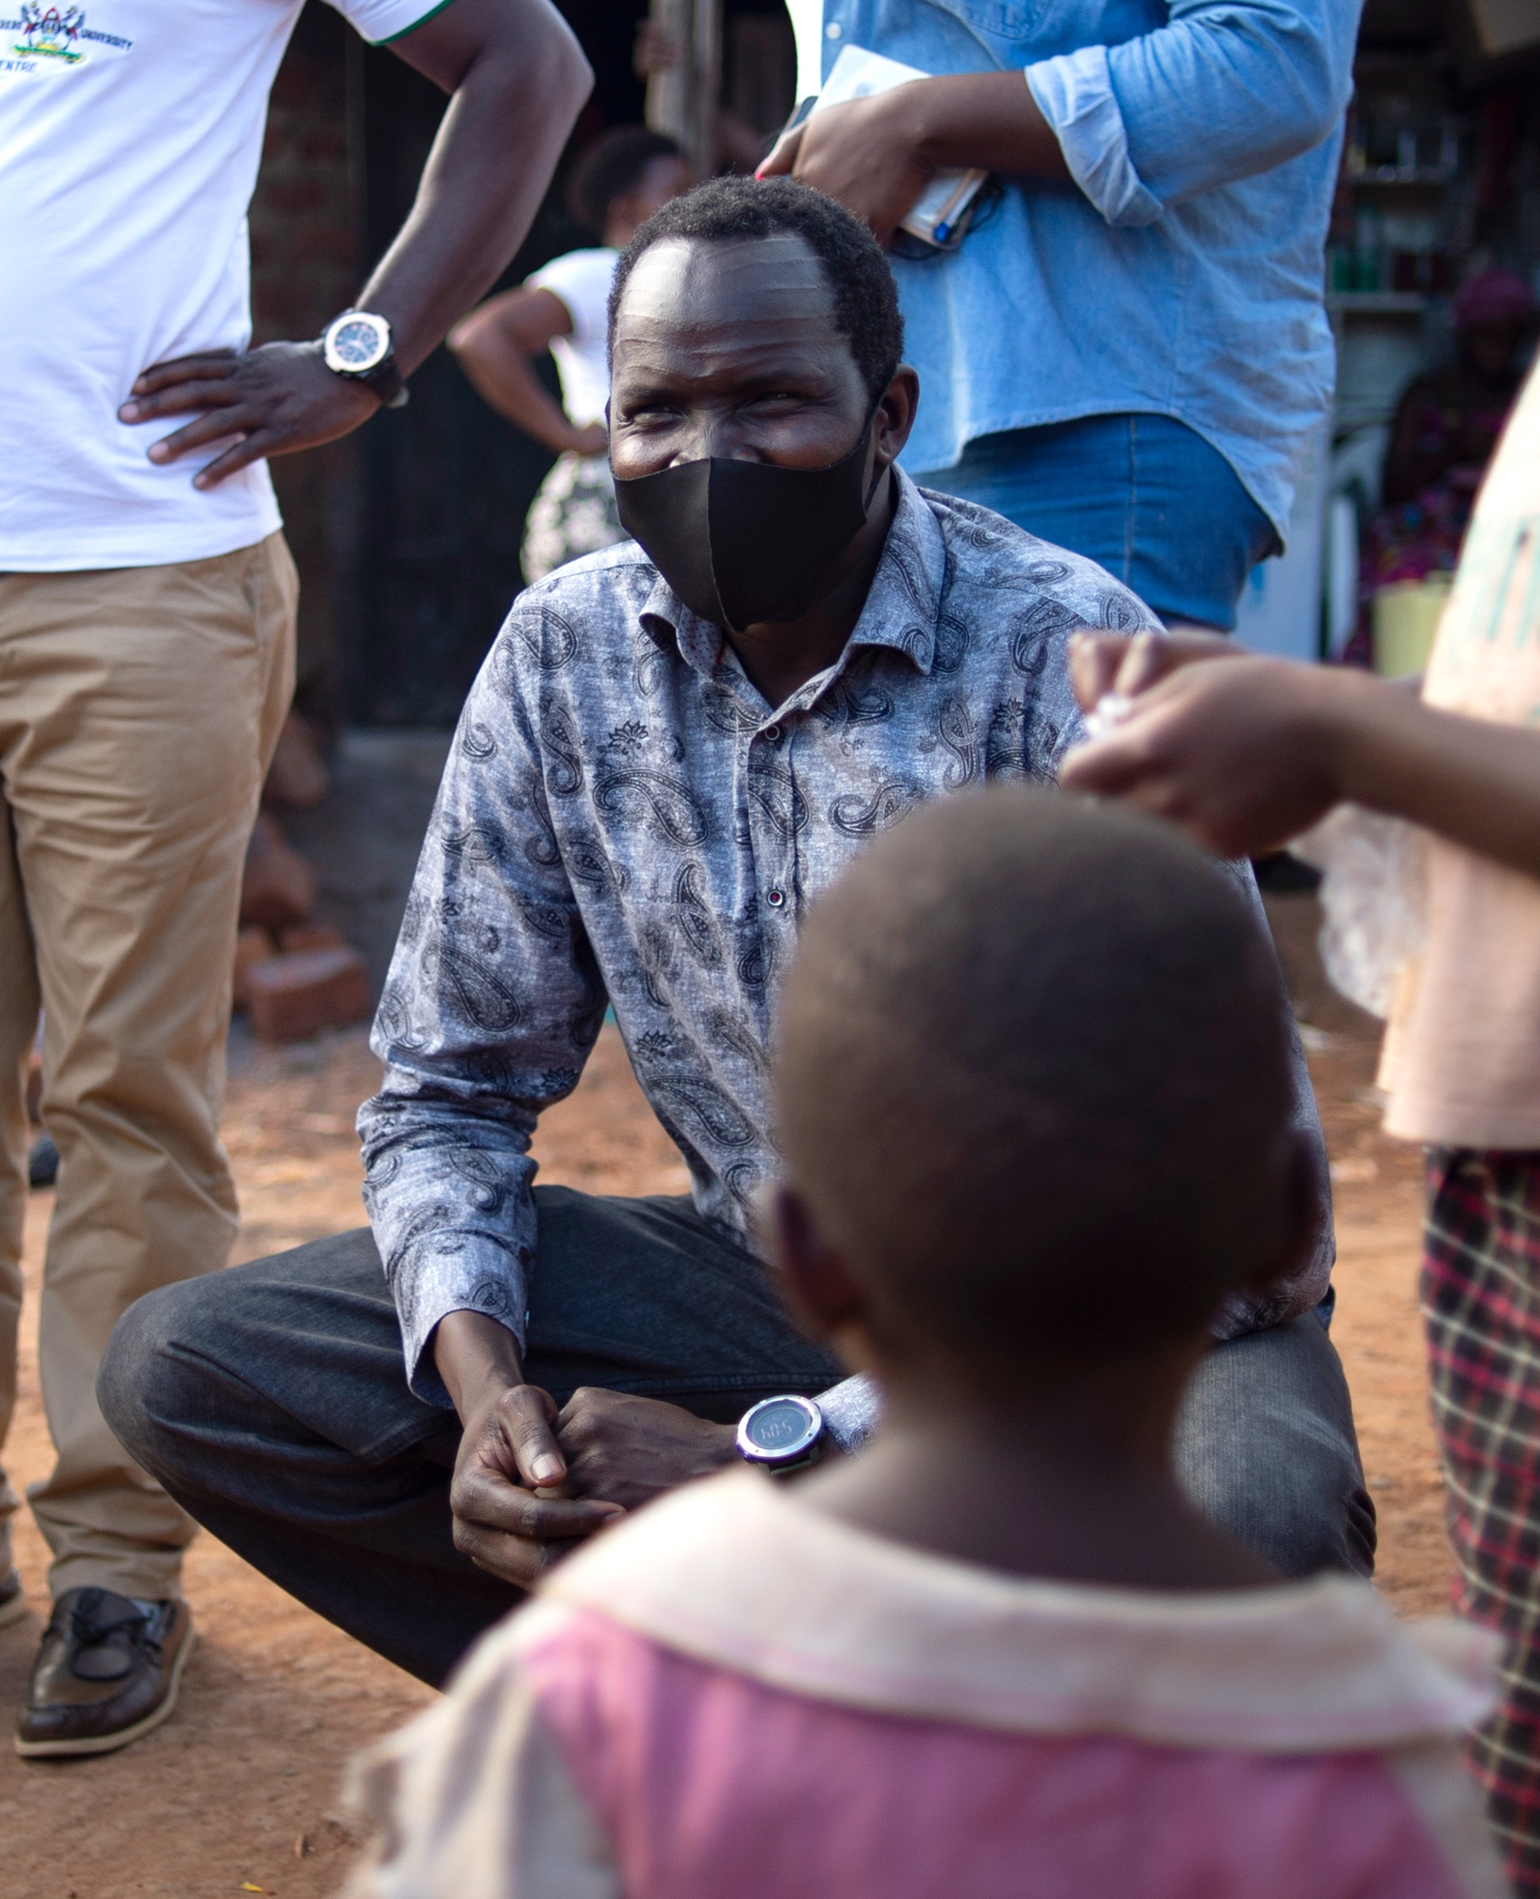

1.4 MILLION MEMBERS
Working together, more than 1.4 million Rotarians and Rotaractors
in more than 46,000 clubs
are bringing positive change to communities worldwide.
GLOBALLY
Notes:
Rotary’s global membership is 1.4 million people of action. Working together, 1.2 million Rotarians and 200,000 Rotaractors in more than 46,000 clubs are making positive change worldwide. The 2019 Council on Legislation gave Rotaract clubs a unique type of membership in Rotary International. This decision elevated Rotaract and positioned Rotary for a future that is innovative and inclusive and can adapt to changing times.

Slide 3
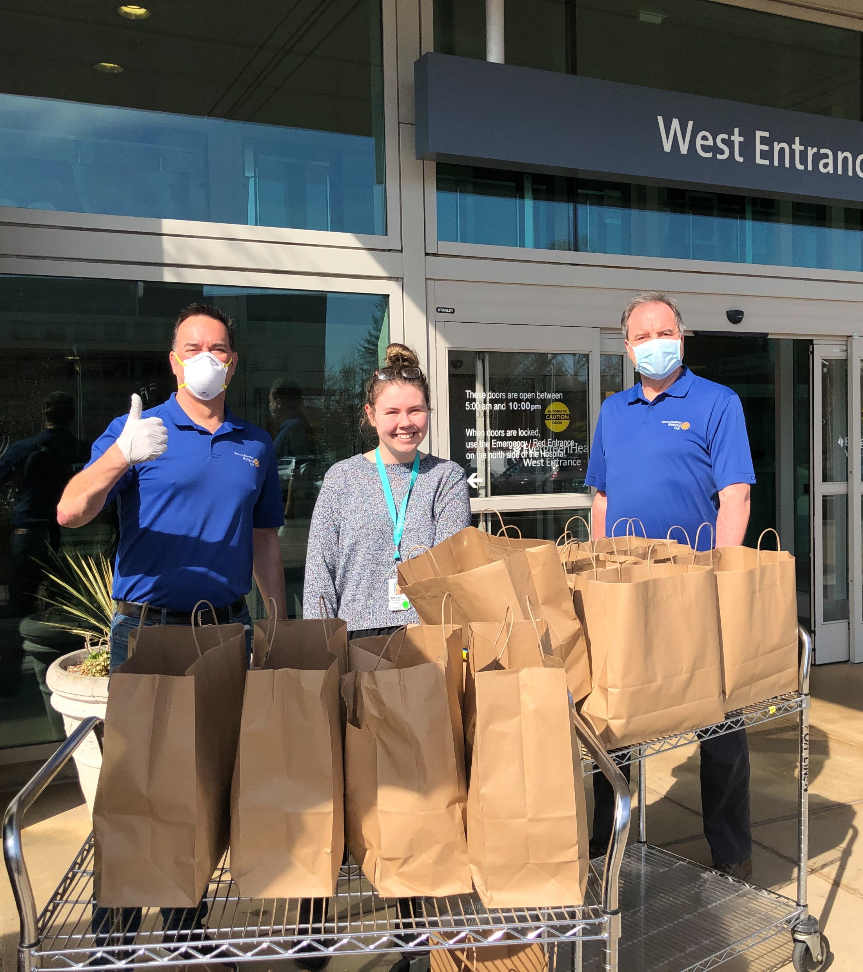
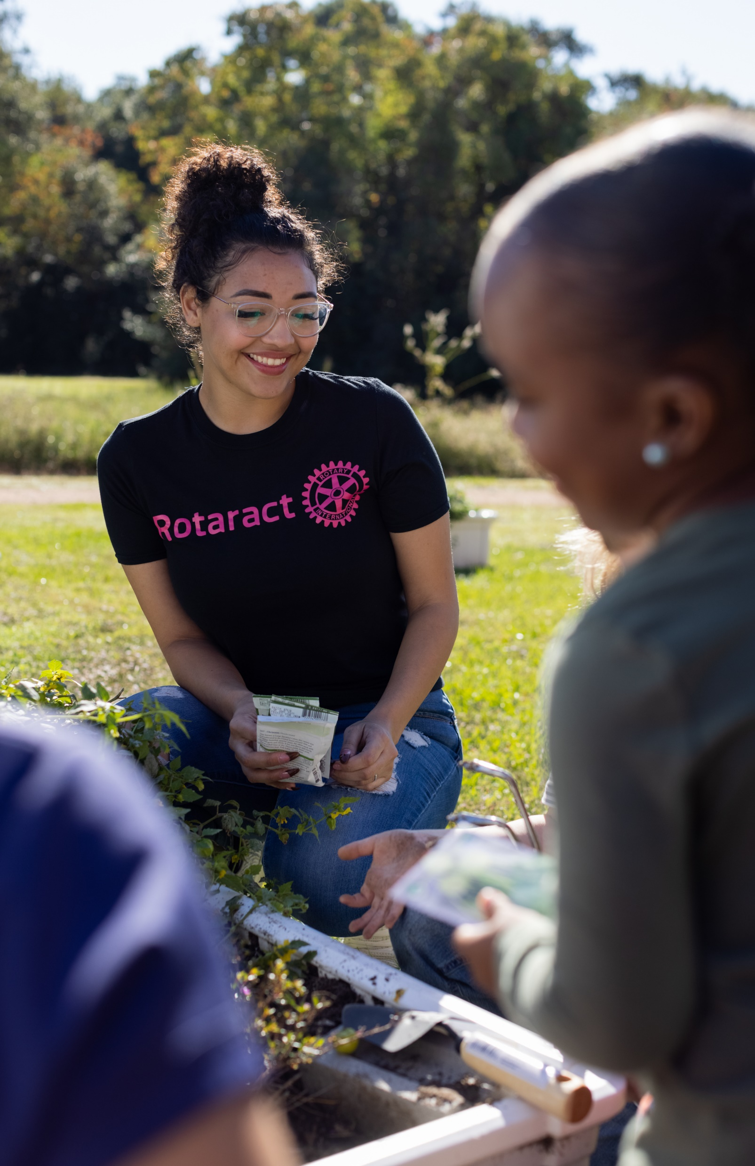
ROTARY
ROTARACT
Notes:
So what’s the difference between these two, distinct membership types? Rotary provides an experience that seeks to engage multiple generations who share the ideals of service, leadership, diversity, integrity and friendship, and wish to have fun while creating lasting change in the world, in their communities, and in themselves. While Rotaract appeals to young adults who prefer to grow their service, professional and leadership skills through a fun and inclusive near-peer network of like-minded people of action.
We know that whether they’re studying at a university or starting a career, Rotaractors add so much to our membership and are Rotarians’ equal and valued partners in service. They can be appointed to district positions and be nominated for awards to recognize their efforts. Let’s continue to look for ways to engage Rotaractors in everything we do.

Slide 4

WORLDWIDE | AS OF 1 JANUARY 2022 | SINCE 1 JULY 2021 | COMPARED TO 1 JANUARY 2021
Rotarians | 1,186,303 | + 23,540 | + 10,941
Rotaractors | 234,408 | + 13,981 | + 9,626
Rotary Clubs | 37,043 | +429 | + 632
Rotaract Clubs | 10,815 | + 505 | - 410
25% of Rotarians are women
52% of Rotaractors are women
Notes:
We have seen some encouraging growth since 1 July 2021, including:
An increase of more than 23,000 members of Rotary clubs and almost 14,000 members of Rotaract clubs. We have also seen an encouraging increase in the number of Rotary and Rotaract Clubs.
You can see that we are also showing a net positive for members when compared to a year ago, in January 2021.
We have more Rotary clubs than a year ago, but around 400 fewer Rotaract clubs. The rate of new club development varies widely around the world, with regions that are experiencing the greatest declines simply not replacing nonfunctioning clubs with new ones that appeal to their communities.
Rotaract has achieved gender parity, with women as 52% of members. Rotary clubs are 25% women, with a slight increase since the previous year. This varies by region, with Japan at the lowest end — only 7% women. India follows with only 14%. The Caribbean leads the world with 40% women.

Slide 5
KINDS OF clubs
SATELLITE:
Members run
the club in collaboration with a sponsor club but choose their club’s structure themselves
PASSPORT:
Members attend meetings of any club, in their community or around the world
CORPORATE:
Members (or most of them) work for the same employer
CAUSE-BASED:
Members unite
to address a particular cause
AND MORE!
ROTARY.ORG/START-CLUB
Notes:
NOTE TO SPEAKER: Consider showing the two-minute “Rotary Anytown” video (https://www.youtube.com/watch?v=e-55H9nVdss) before or after this slide.
SPEAKER: We know from tracking data year over year, is that new clubs have traditionally driven our growth. As many as 88% of charter members of new clubs are first-time Rotarians.
As you can see from some of the models listed here, new clubs can accommodate different demographic groups and offer more meeting times and formats. The regions that started the most clubs over the last five years also have the strongest membership growth. Conversely, the regions with the greatest net loss in clubs also lost the most members.
But membership growth is only one of the benefits of starting new clubs. When we asked new club development advocates, they said that starting new clubs also engages existing members, increases diversity overall, makes Rotary more visible in communities, and increases the opportunity to partner with other community organizations.

Slide 6
District xxxx:
XXXX MEMBERS
+/− XXX from 2017
XX CLUBS
+/− XXX from 2017
TREND, AS OF <INSERT DATE> | DISTRICT | WORLDWIDE
Men, women | XX%, XX% | 75%, 25%
New member retention | XX% | 79%
Existing member retention | XX% | 77%
Members under age 50 | XX% | 16%
Members over age 50 | XX% | 46%
Age not reported | XX% | 37%
Notes:
NOTE TO SPEAKER: Get your area’s age and gender trends from the dashboard in Rotary Club Central. To add district data to this slide, leaders at the district level and above can go to Rotary Club Central’s Reports to get the District Membership Profile for their district.
Replace the X’s on the slide and in the notes with data from Rotary Club Central, or delete them. Unhide the slide (in the Slide Show menu, choose Hide Slide) so it’s visible during the presentation. Compare global trends with what’s happening in your region.
SPEAKER:
Here’s the profile for District XXXX, as of <XXXX>.
We have XX clubs and XXXX members. As for retention:
xx% of those who joined before 1 July of this year are still members.
xx% of those who joined after 1 July are still members.
<Add your observations>
Age and gender: Our district’s members are xx% men and xx% women, and this has changed [greatly/somewhat/a little] over three years. xx% are under 40, and xx% have not reported their age to Rotary. <Add your observations.>

Slide 7
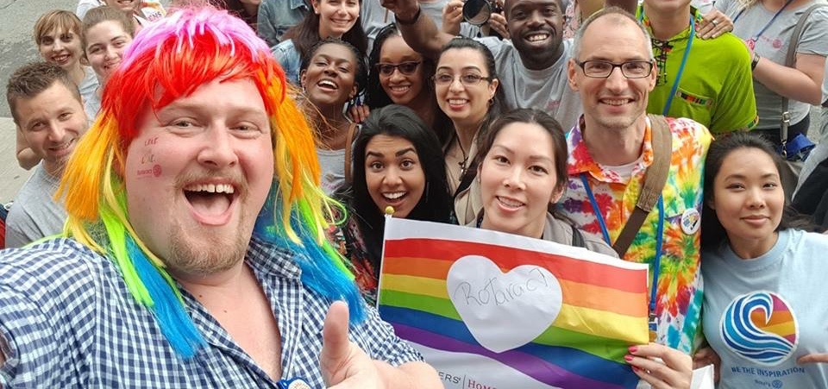
EACH ONE, BRING ONE
“Friends, to live for others, to care for others, to serve others and change their lives is the best way to live our own lives.” — RI President Shekhar Mehta
ROTARY.ORG/JOIN
Notes:
Another way we can grow Rotary is by embracing the call to action “Each One, Bring One.” Inspired by all the good he has been able to do through Rotary, RI President Shekhar Mehta is asking every Rotarian and Rotaractor to sponsor just one new member this Rotary year. Research shows that 87% of Rotarians and 41% of Rotaractors were introduced to their clubs through invitations from current members. This makes sense because we’re the undisputed pioneers of service leadership grounded in personal connections. So let’s look for every opportunity to connect with people who share our values and want to make a difference.

Slide 8
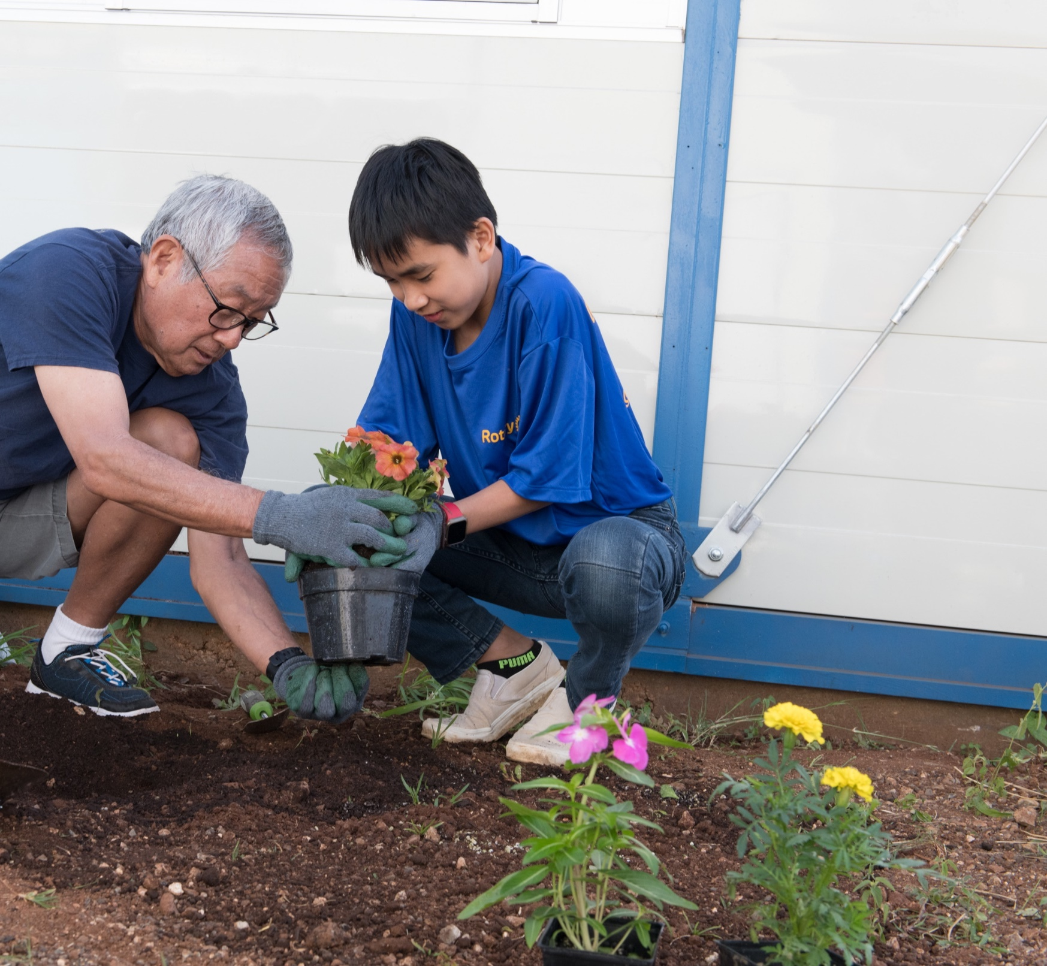



WHAT MEMBERS WANT
Local community service
Connecting with others
Professional & leadership development opportunities
Notes:
We also know that continuing to meet our members’ expectations is both a challenge and an opportunity. We can’t add members to clubs while overlooking the importance of offering everyone an engaging experience.
Rotarians and Rotaractors have slightly different priorities in their reasons for joining and staying, but generally, they are looking for three things: Local service, connecting with others, and professional and leadership development opportunities.
And while these trends are important, we cannot assume they apply to everyone who becomes a member. We need to take the time to understand the unique reasons our members chose us over other service organizations – and we need to know what they expect from us. What do they want out of their Rotary involvement? And how do they aspire to change and influence our communities and our world, through their membership?
When we start by asking what a member wants, and then try to meet their expectations, we show them that we care. That their unique skills matter to us. This is so important because we now know there is a compelling connection between member satisfaction and member retention.

Slide 9

FACTORS THAT INFLUENCE
MEMBER SATISFACTION:
Comfort with other club members
Club’s positive impact in the community
Confidence in club leadership
Enjoying club meetings
FACTORS THAT INFLUENCE
MEMBER RETENTION:
1. Comfort with other club members
2. Enjoying club meetings
Notes:
Over and over our surveys find that the comfort and care of our members, is the single greatest driver of member satisfaction and our most powerful tool to keeping our members engaged in our clubs. As comfort increased, the probability of having a higher satisfaction with membership increased as well.
In fact, a member who is not at all comfortable with other members is two to four times more likely to terminate their membership than a member who is extremely comfortable.
This applies not just to current club members, but to anyone and everyone who engages with Rotary. No matter who they are, where they are in the world, or how long they have been connected with us — all members, prospective members, and other participants, deserve and expect to feel valued, respected, and welcomed.

Slide 10
VISIT ROTARY.ORG/DEI
DIVERSITY
Welcoming people of all backgrounds, cultures, experiences, and identities
EQUITY
Ensuring that each person has access to the resources, opportunities, networks, and support they need to thrive
INCLUSION
Creating a culture where each person knows they are valued and belong
We are committed to being honest and transparent about our DEI journey
and to continuing to learn and improve.
Notes:
Diversity has long been one of Rotary’s core values, and it guides our interactions with one another and our communities. But we know we need to learn more and do more to make sure that our organizational culture exemplifies diversity, equity, and inclusion. That’s why we recently strengthened our commitment to DEI and created a DEI Code of Conduct.
We expect Rotarians and Rotaractors to exemplify this code of conduct as they interact with
one another, Rotary program participants, Alumni, project partners, and members of the community. This code of conduct is one of many tools we have that will contribute to a
collaborative, positive, and healthy club environment.
As we continue to focus on this work, let’s make sure we understand and are using the words the same way:
Diversity means that people of all backgrounds, cultures, experiences, and identities are welcome in Rotary.
Equity means getting everyone the resources, opportunities, networks, and support that they need to thrive. We recognize that certain groups have historically experienced barriers to participation, membership, and leadership, and we commit to advancing equity in all aspects of Rotary, including our community partnerships.
Inclusion means we strive to create a culture where each person knows they are valued and belong. It comes from our belief that all people have qualities that make them unique.
As Rotary International President-elect Jennifer Jones reminds us, “As we strive to weave diversity, equity, and inclusion into Rotary, removing the barriers is the key to inclusion. And inclusion is the key to membership.”

Slide 11
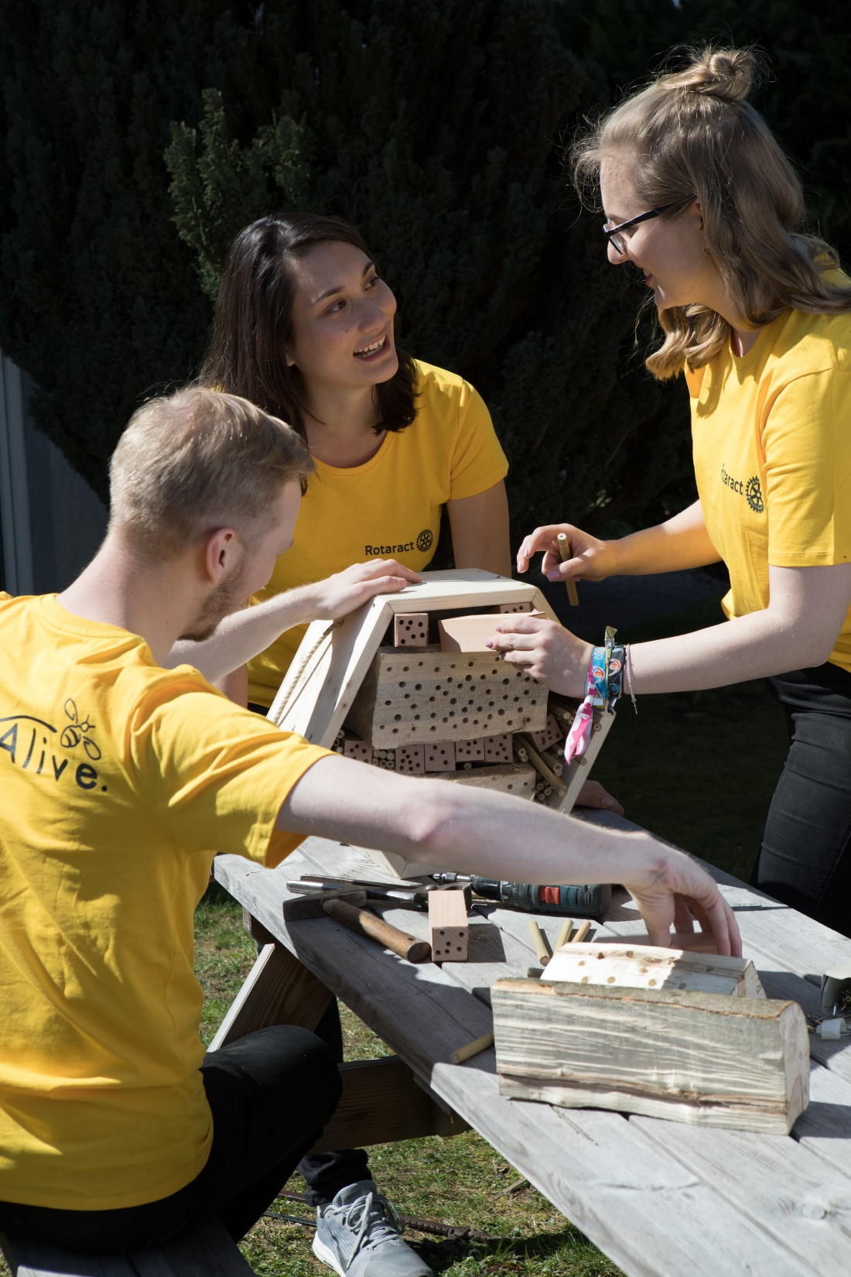
Prioritize
THE MEMBER EXPERIENCE
Members who have a positive Rotary experience are more likely to stay.
In turn, they create a positive Rotary experience for others, because their enthusiasm is contagious.
ROTARY.ORG/MEMBERSHIP
Notes:
Everyone in Rotary should have opportunities to express what they want from their membership, and that starts by examining inclusion in our own clubs. Remember that what someone joins for may not be what they need years later.
At rotary.org/membership, we have plenty of resources that can help you meet members’ needs.
Here are a few examples:
Two new, online courses for creating a welcoming club environment and diversifying your club are now available.
The Club Health Check and the Club Planning Assistant help club leaders reflect on their club’s culture and offer recommendations for improving the overall club experience, service projects, social events, business operations, and public image.
And the Membership Satisfaction Survey can be given to club members to determine what they like and don’t like about their club experience.

Slide 12
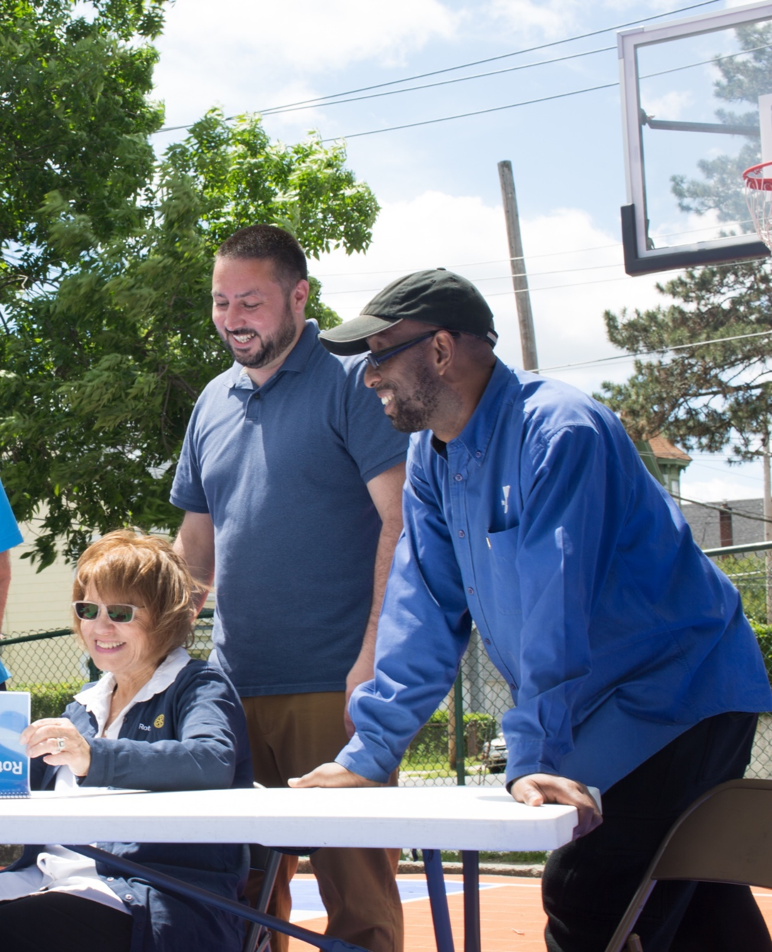
Enhance participant engagement
Now more than ever, we can connect with each other differently. We can offer more opportunities for people to attend our meetings, support their communities, and grow personally and professionally.
ROTARY.ORG/FLEXIBILITY
Notes:
Now more than ever, we have the chance to connect with each other differently — to offer more ways for people to attend our meetings, support their communities, and grow personally and professionally.
Our clubs are making exciting changes to adapt to the diverse needs of their members and communities. They’re:
Meeting online or both in person and online. This makes meetings accessible to more people.
Encouraging members to take advantage of the professional development catalogue in Rotary’s learning center.
Starting satellite clubs to give prospective members who couldn’t otherwise attend their meetings a chance to join Rotary.
Changing how, when, and how often they meet. Some are meeting just twice a month or changing sit-down meals to less formal and less expensive gatherings, or replacing some meetings with social events or service projects.
Introducing members to opportunities beyond the club, such as getting involved in district leadership or joining a Rotary Action Group or Rotary Fellowship.

Slide 13
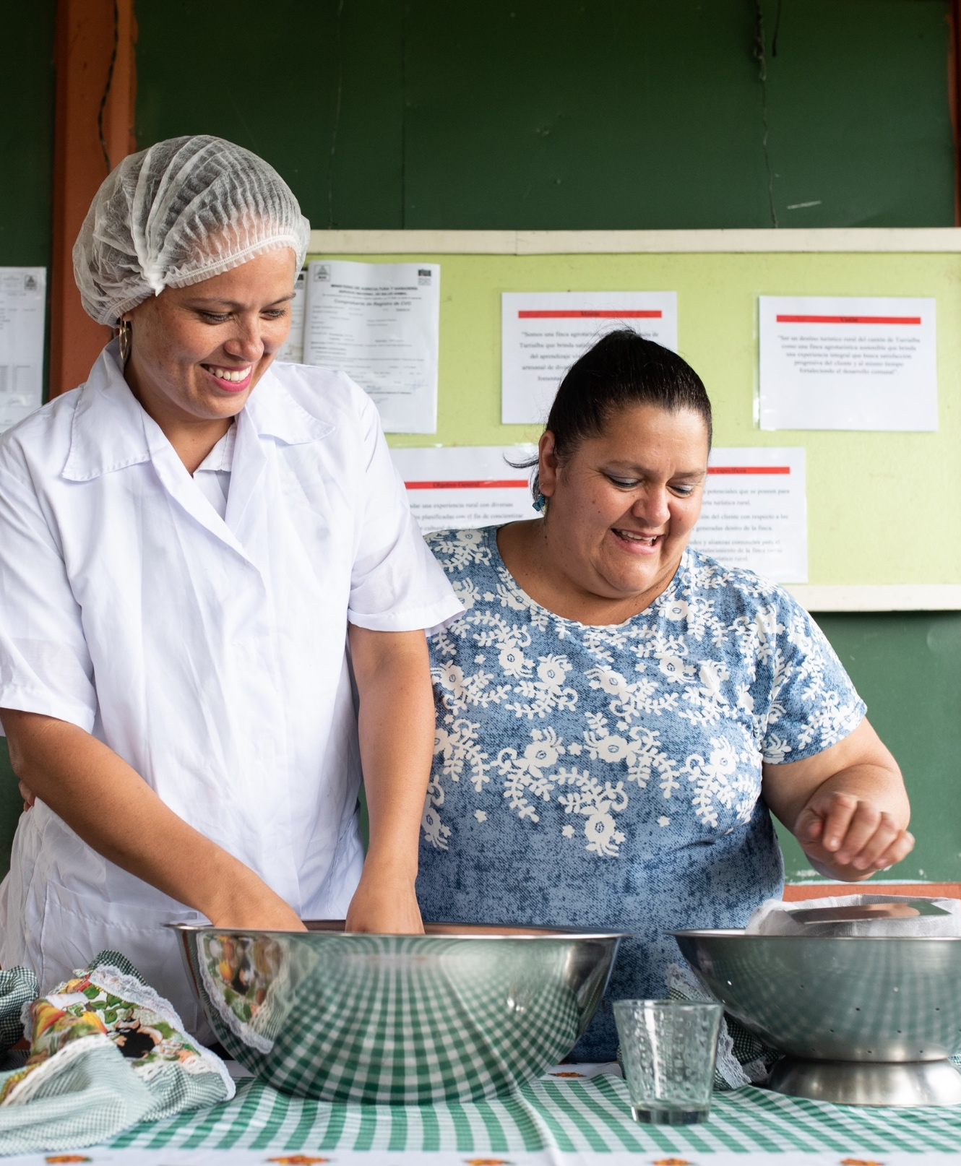
Expand our reach
There are all kinds of leaders in our communities, and we want them to be connected to Rotary.
Let’s expand our ideas about who can be a leader. Let’s recognize potential people of action. And then talk to them about how we can all benefit from their participation.
ROTARY.ORG/STRATEGICPLAN
Notes:
And inclusion extends to how we work with communities. Let’s look around our communities and see how people are connecting through shared cultures or interests. Let’s expand our understanding of who can be a leader. Let’s see people’s potential for action. And then help them use it.
This could mean:
Talking to them about how we can all benefit from their participation in our activities and events.
Starting a cause-based club to attract members who are passionate about a specific issue, like water or peace.
Inviting Rotaractors to serve on district committees or lead in other ways.
Offering new membership options, like corporate membership for employees of the same company, or associate membership for young professionals who want an option that costs less or requires less time.
Starting a Rotary Community Corps with people who share our commitment to change through service.
We all want a stronger, more effective Rotary. A Rotary that’s more adept at using partnerships, digital tools, and new ideas to bring people together. More diverse voices in our clubs and in our leadership will help Rotary stay relevant in a changing world.

Slide 14
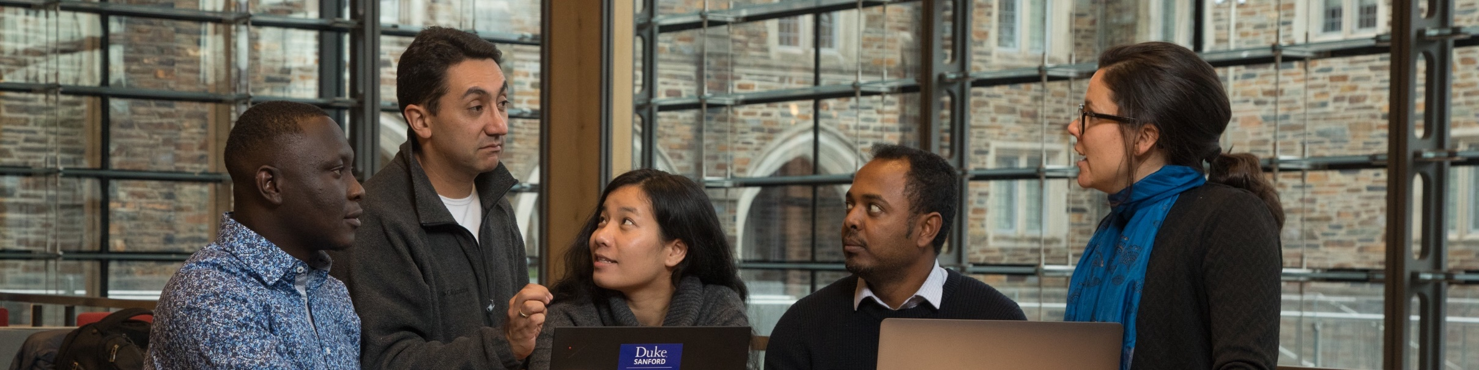




TAKE ACTION
LEARN
ASK
COMMIT
ROTARY.ORG/MEMBERSHIP
Notes:
Increasing membership while also continuing to eradicate polio, fight COVID-19, and serve our communities is an ambitious goal. But our members can meet the challenge.
What can you do? Here are four things:
Take time to understand regional membership trends. Rotary Club Central makes it easy to get information about membership in your area.
Find out what matters most to members. What do they value? What is missing for them? What do they need to stay a member for life?
Talk about how you can improve members’ experience in your clubs. Are we meeting the expectations of our members? What would we gain by being more diverse and inclusive? What is preventing us?
Finally, Visit rotary.org/membership. It has resources to support you, whether you need club assessments, information on starting new clubs, or offering different membership types.

Slide 15
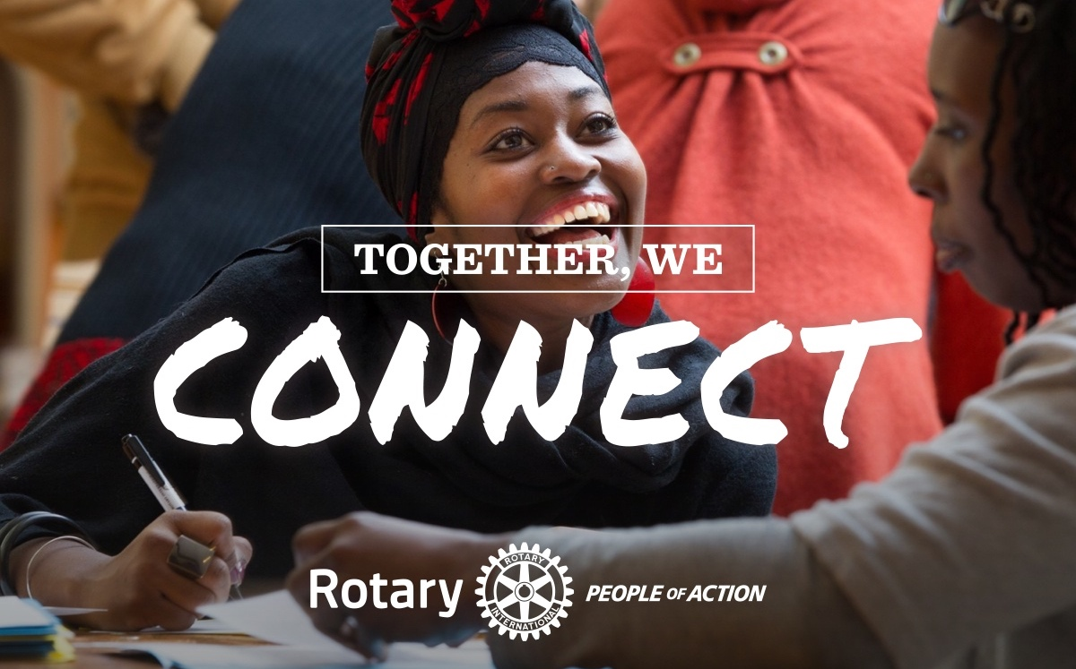
Notes:
When people connect with Rotary, their potential to make a difference grows exponentially. That’s because they’re connecting to a diverse network of more than 1.4 million people of action — from all over the world — who share a goal of improving people’s lives.
Again, to quote Jennifer Jones, “Imagine a world that deserves our best, where we get up each day knowing that we can make a difference. You don’t imagine yesterday. You imagine tomorrow.”
Together, we see a world where people unite and take action to create lasting change — across the globe, in our communities, and in ourselves.
Thank you.
Does anyone have a question I can answer?
NOTE TO SPEAKER: Write to membershipdevelopment@rotary.org with any questions.

